Slide 1
Levenshtein Distance
Similarity algorithm

Slide 2
What is Levenshtein Distance?
Have you ever wondered how word processors like MS Word and Google Docs can identify misspelled words and provide suggestions? These word processors use multiple string algorithms to match each word written by the user against the words in their dictionary. Now, identifying misspelled words can be done using a standard String Matching algorithm. However, to provide suggestions, the processors need to find a list of such words that are close similar to the misspelled word. In simpler words, the processor needs an algorithm that computes the similarity between two words. This can be calculated by finding the Levenshtein Distance between the two strings.

Slide 3
Overview
Levenshtein Distance, also known as Edit Distance, is a measure of similarity between two strings of characters.
Given two words, the Levenshtein Distance is defined as the number of characters needed to be inserted, deleted, or replaced in one string, to transform it into another string.
The algorithm returns a numeric value representing the similarity between the two strings. Less is the Levenshtein distance, more is the similarity.

Slide 4
Levenshtein Distance is a Distance Metric
A distance function is a distance metric if it is a function from pairs of objects to real numbers such that:
levenshtein(x,y) > 0. (non-negativity)
levenshtein(x,y) = 0 if x = y. (identical)
If y is empty :levenshtein(x,y) = length of (x)

Slide 5
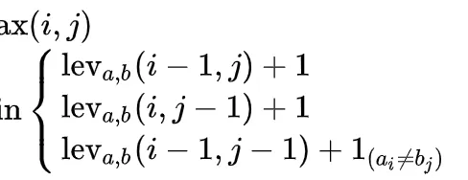
Levenshtein Distance algorithm
Levenshtein Distance is a function that take two strings and returns a real number

Slide 6
How Levenshtein Distance works ?
calculates the distance between two words and returns a number representing how similar the words are. The number represents the total number of edits required to transform one word into another. There are three ways by which the editing can be done:
Insertion A new character can be inserted anywhere in the given string. Example: A: "helo" B: "hello" We can insert the character 'l' at position 4 in string A to get string B.
Deletion A character can be deleted from anywhere in the given string. Example A: "helloo" B: "hello" We can delete a character at position 6 in string A to get string B.
Replacement A character can be replaced with the other character. Example A: "hella" B: "hello" We replace the character 'a' with 'o' at position 5 in string A to get the string B.
Each of these operations adds 1 to the edit distance.

Slide 7
Problem Statement
Consider two input strings A and B of length n and m respectively, containing lowercase English letters only. The problem is to find the Levenshtein distance between A and B using the following edits:
Insert a character in A
Delete a character from A
Replace a character in A with any other character.
Note: The cost of each operation is 1.

Slide 8
Algorithm (Using sub-subproblems)
Levenshtein distance between two strings can be found using dynamic programming. The algorithm exhibits the property of overlapping subproblems.
Consider the strings A and B.
Case 1: A[1]=B[1]. In this case, we can skip the first position and the edit distance of the whole problem is equal to the edit distance of A[2:n] and B[2:m]. Here S[I : j] means substring of S from position i to position j.
Case 2: A[1]≠B[1]. In this case, we will use the three operations mentioned above to find the edit distance.
Insert B[1] in A: The edit distance is equal to 1 + the edit distance of A[1:n] and B[2:m]. This is because the first character in B matches the newly added first character in A.
Delete A[1]: The edit distance is equal to 1 + the edit distance of A[2:n] and B[1:m]. This is because we have simply deleted the first character in A. The characters left in both strings will contribute to the edit distance of the whole problem.
Replace A[1] with B[1]: The edit distance will be equal to 1 + the edit distance of A[2:n] and B[2:m]. The edit distance will be the minimum cost of inserting, deleting, or replacing the characters in A to get the string B.
The general idea of the algorithm is to transform the prefix of string A[1:i] equal to the prefix of string B[1:j] using the minimum number of insert, delete and replace operations. At every mismatch, we need to apply the three types of edit and choose the operation that minimizes the overall edit distance of the problem.

Slide 9
Example
Let us consider an example where A = "gate" and B = "goat". To calculate the Levenshtein distance, we will use the above approach.
Since [1]A[1]=B[1]: we simply move to the next character.
Since A[2]≠B[2]: we have three choice. If we perform:
Insert: We get A = "goate" and B = "goat".
Delete: We get A = "gte" and B = "goat".
Replace: We get A = "gote" and B = "goat".
Now if we look at the choice where we insert an element, we see that deleting the last character from A = "goate" will transform it into the string B. Hence in this case the edit distance will be 2. In the rest cases, we see that the number of operations will be more, so we take the minimum of the three cases. Edit Distance of A = "gate" and B = "goat" is 2.

Slide 10
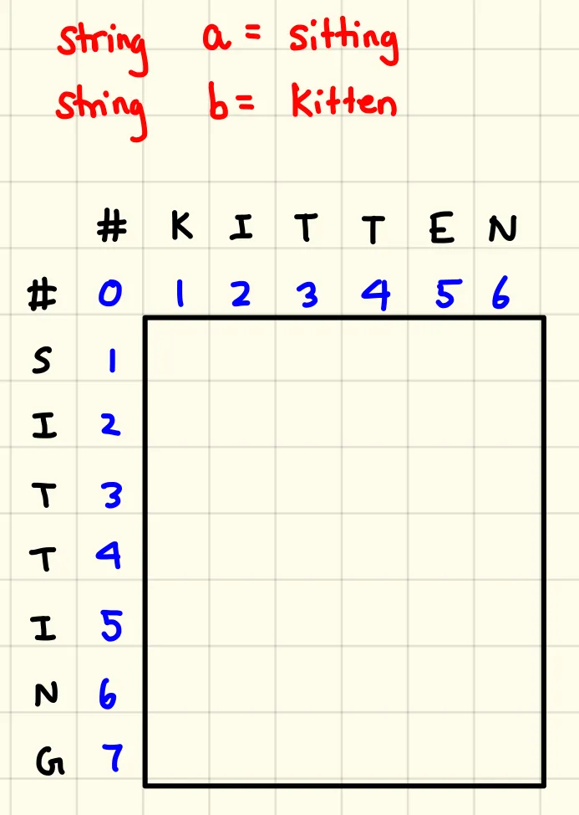
Example Using a Matrix
The Levenshtein distance for strings A and B can be calculated by using a matrix. It is initialized in the following way:
From here, our goal is to fill out the entire matrix starting from the upper-left corner. Afterwards, the bottom-right corner will yield the Levenshtein distance.

Slide 11
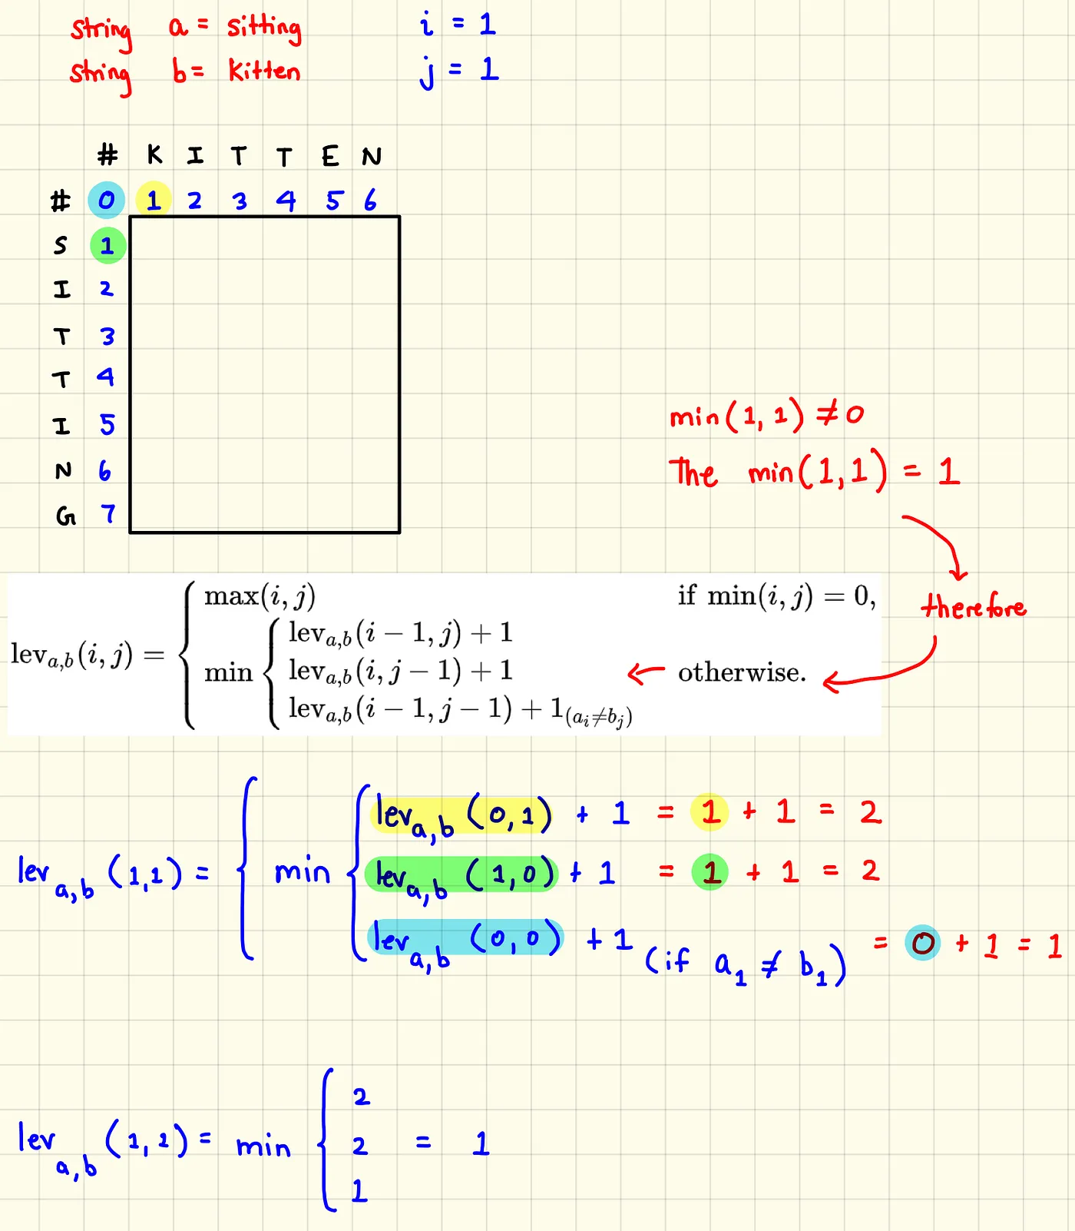
cont
Let’s fill out the matrix by following the piecewise function.

Slide 12
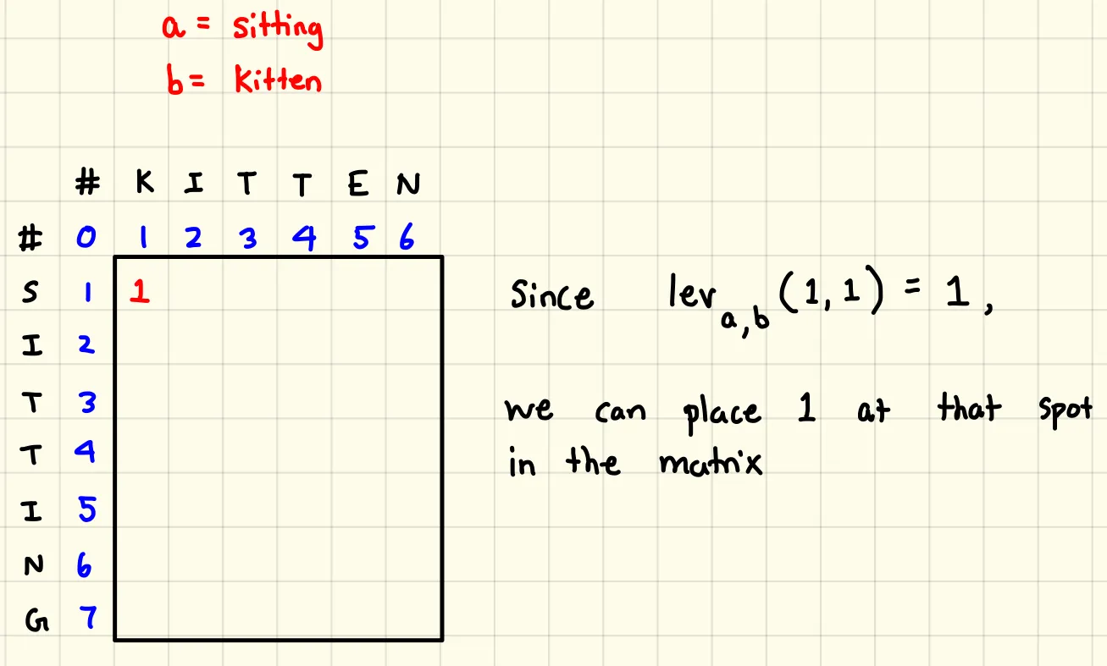
cont
Since lev(1,1) = 1
We can place 1 at the spot in the matrix

Slide 13
cont
Now we can fill out the rest of the matrix using the same piecewise function for all the spots in the matrixes.

Slide 14
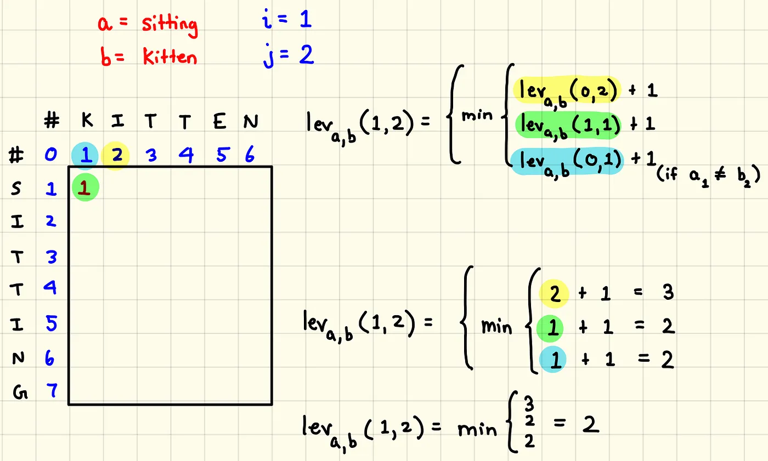
cont
Repeat the first step to fill the second cell

Slide 15
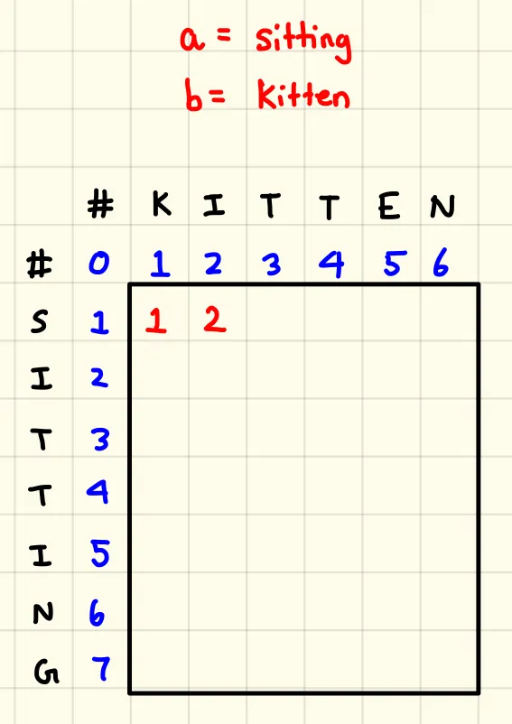
cont
Since lev(1,2) = min(3,2,2) = 2
We can place 2 at the spot in the matrix
Now with the equation at this point, we can try to fill out the rest of the matrix.

Slide 16
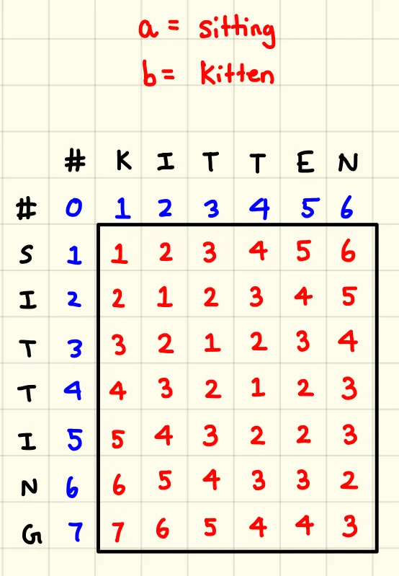
cont
The final result is:

Slide 17
Advantages and disadvantages.
Advantages:
Limitations:
It can handle strings of different lengths.
It considers all types of edits (insertions, deletions, and substitutions).
It provides a quantitative measure of similarity between strings.
It is useful for tasks that involve comparing and matching textual data.
It can be computationally expensive for long strings.
It treats all characters equally and does not consider semantic or contextual meaning.
It may not perform well for tasks that involve comparing or matching large documents or text corpora.

Slide 18
Conclusion
Levenshtein distance is used to measure text similarity between two strings. It is equal to the number of edits (insert, delete, replace) required to convert one string into another.
The Levenshtein algorithm exhibits the property of overlapping sub-problem, hence dynamic programming is used to calculate the same.
Levenshtein algorithm is also available as an inbuilt function in the pyenchant library. When developing a spell checker, can be very helpful.

